Slide 1
AI for Kids
UK Robotics Week 2024

Slide 2
This Story is about my story is about a good student Primary School pupil using generative AI efficiently and ethically to learn for the drops of tomorrow
This story is created by:
John
Mary
Manal

Slide 3
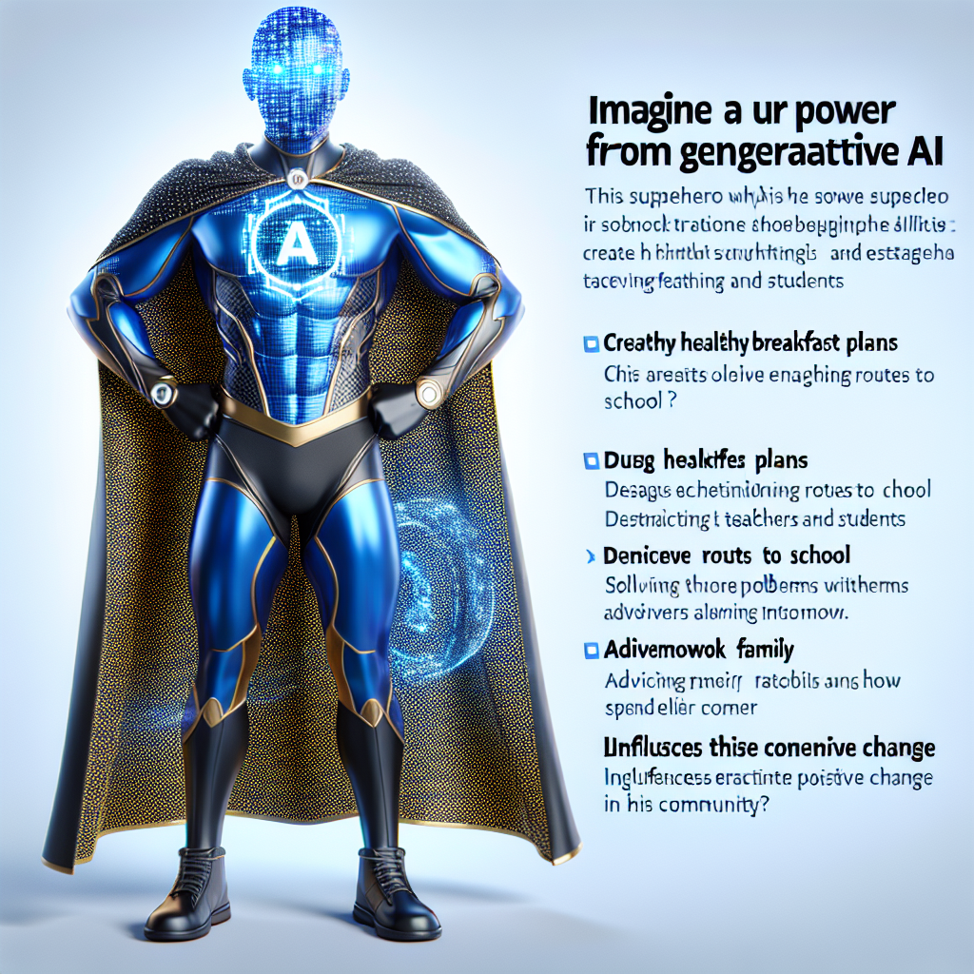
The superhero starts their day by using generative AI to help plan a healthy breakfast and organize their school day. They also use AI to engage with teachers and classmates, study efficiently, and assist
their family with leisure activities. The superhero is eager to use AI to enhance their learning experience and is interested in integrating AI into various aspects of their daily routine to optimize productivity and efficiency.
Imagine a unique superhero whose power is derived from generative AI. This superhero uses his abilities to create healthy breakfast plans, devise efficient routes to school, and establish engaging interactions with teachers and students. Additionally, the superhero uses generative AI in solving homework problems and advising family on how to spend leisure time. Given these abilities, this superhero influences positive change in his community. Trade mark attire is blue and gold outfit with a silver 'A' emblem signifying AI on the chest. His black cape is covered with tiny pixelated patterns symbolising data.

Slide 4
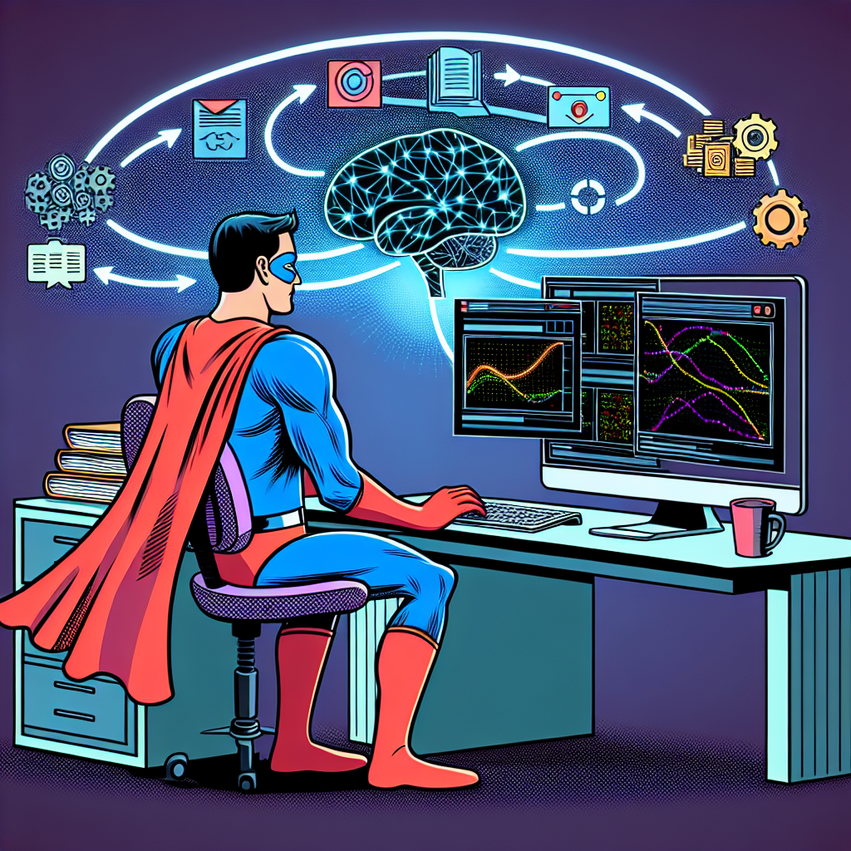
In the first presentation, the superhero starts the day early with generative AI, has a healthy breakfast, plans for school, engages with teachers and classmates, and helps family with leisure activities. In the second presentation, the superhero continues using generative AI for breakfast and school plans, studies, interacts
with others, and organizes family leisure. In the third presentation, the superhero explores using AI for learning history, incorporating human input in reinforcement learning with AI. In the fourth presentation, the superhero extends the use of generative AI to school work, homework, and advising family on leisure activities.
Illustrate an image of a superhero character, wearing no identifiable superhero costume but rather casual clothing, sitting at a computer. The superhero is using a machine learning algorithm on their computer, which is represented graphically by a glowing, intangible brain symbol hovering above the screen. The software is showcasing various historical events. Simultaneously, the superhero is interacting with a reinforcement learning model within an abstract representation of a loop, symbolizing their role as a human-in-the-loop reinforcement learning.

Slide 5
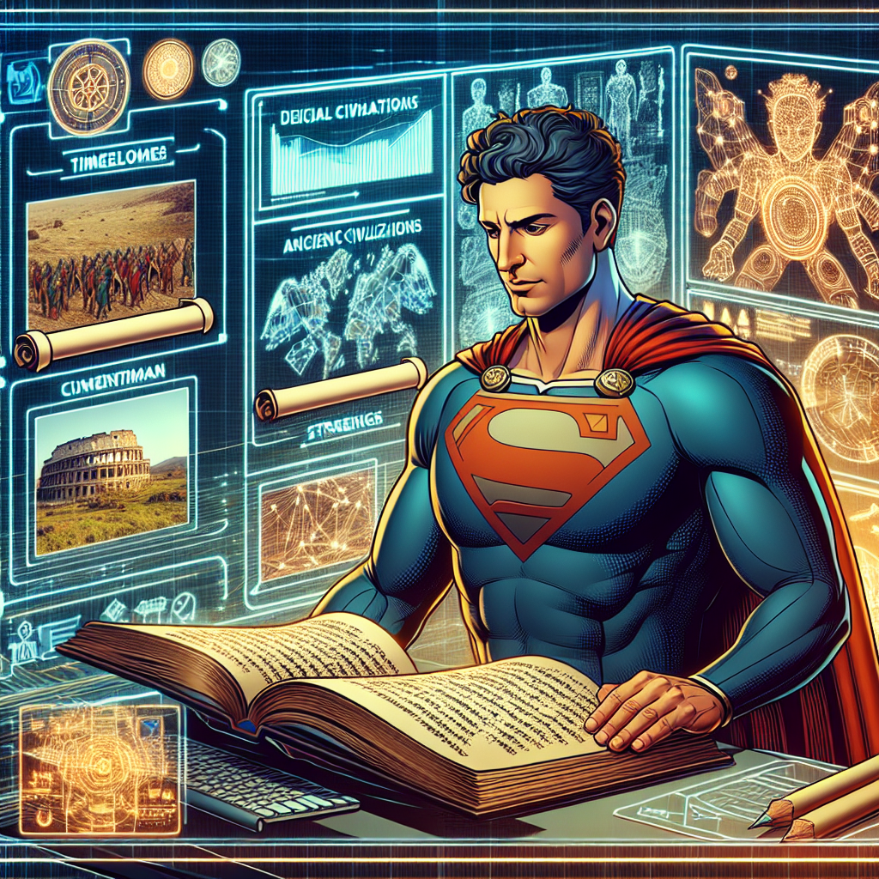
In the world of superheroes, our protagonist starts the day with generative AI, tackling breakfast planning before school. They navigate interactions at school with the help of AI,
even using it for studying and homework. Delving into history, our hero becomes a human-in-the-loop for reinforcement learning algorithms, mastering ancient civilizations with the aid of generative AI.
An illustration of a superhero interested in history. Depict him deeply engrossed in studying ancient civilizations using generative AI. Add elements such as scrolls depicting timelines or images of civilizations, a high-tech holographic interface or screen presenting 3D models of artifacts or structures. Make sure to present the superhero as a diligent academic, showing that knowledge and learning can be as heroic as physical strength. As for his physical appearance, he is a Middle Eastern male with short and curly hair.

Slide 6
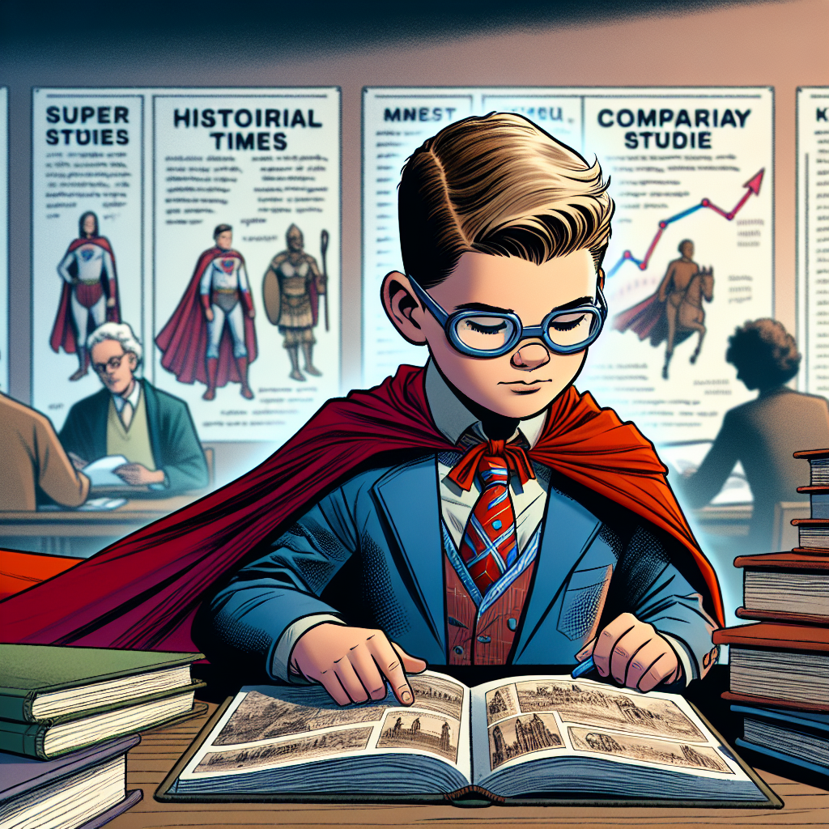
Yes, the superhero uses generative AI for various tasks like planning meals, studying, and leisure activities. He is also interested in learning history and even uses
AI for studying ancient civilizations. As the superhero progresses to university, he continues to explore history from ancient to modern times and does comparative studies as well.
Imagine a scene from a children's storybook where a young superhero is in a university setting. He is deeply engrossed in studying history, spanning across various eras, starting from the ancient times all the way to the contemporary era. His focus lies in performing comparative studies. There are stacks of books around him and historical timelines are visible on the walls. His distinctive cape and superhero insignia are somewhat subdued to blend in with the academic environment, but still recognizable. His eyes filled with determination and curiosity, ready to use this knowledge to better the world.

